Slide 1


Adam Tan Project 2

Slide 2
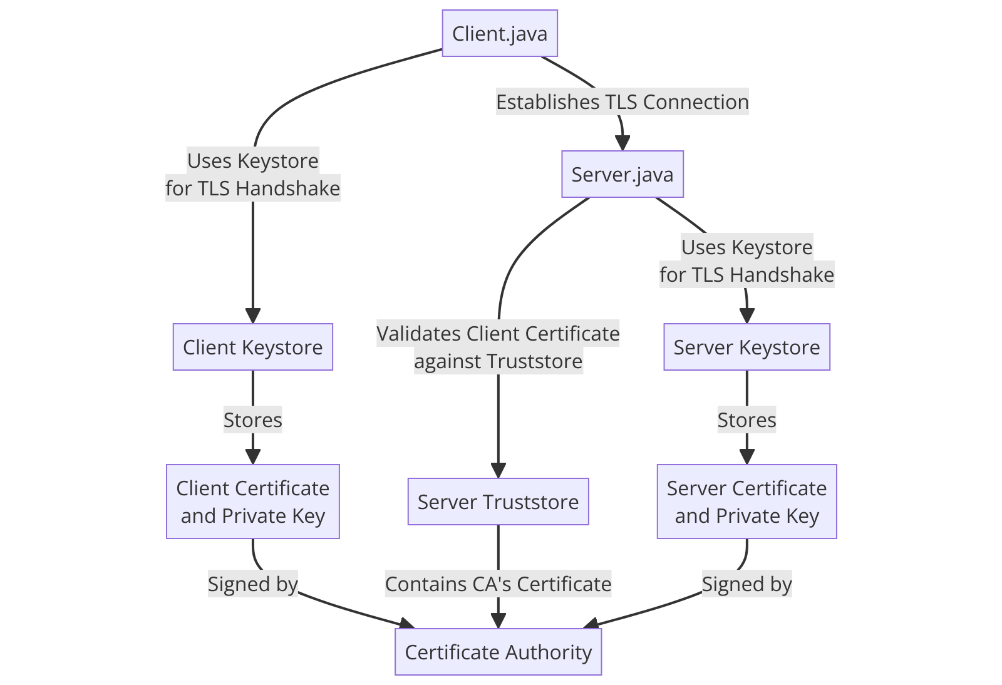
Architectural Overview
Notes:
The CA directory contains all the documents associated with the CA, which are :
CAHospital.key: Private key of the CA to sign certificates, establishing a chain of trust.
CAHospital.pem: Public certificate of the CA and is trusted by both the server and clients, allowing them to verify the authenticity of certificates signed by the CA.
CAHospital.srl: Serial file used by the CA to keep track of the certificates it has issued via the certificate’s unique serial number
Keystores
The keystores contain the private keys and certificates for the users based on their roles within the hospital, which are the doctors, nurses, and patients. Each keystore is protected by a password ensuring that cryptographic materials are securely managed and used for establishing TLS connections.
Truststores (clienttruststore, servertruststore)
These are store trusted certificates, including the CA's certificate and potentially other trusted entities. They are used to verify the identity of the other party while communicating in the TLS handshake.
Server.java: Sets up the server-side of the TLS connection. It will use the serverkeystore to present its certificate and private key during the TLS handshake and uses servertruststore to verify client certificates when client authentication is required.
Client.java: The client-side code to establish a secure TLS connection with the server. Each client type (doctor, nurse, patient) uses its respective keystore to authenticate itself to the server and the clienttruststore to verify the server's certificate.
Logging in
To login, users (doctors, nurses, patients) will use a username and password. The username is the name of their respective keystore file, and the password is the password protecting that keystore file. By using the password used to access the keystore, this ensures that the user is authorized to use the associated private key and certificate.
The passwords for the keystores I have created are - doc1pw, doc2pw, nurse1pw, nurse2pw, patient1pw, patient2pw.

Slide 3
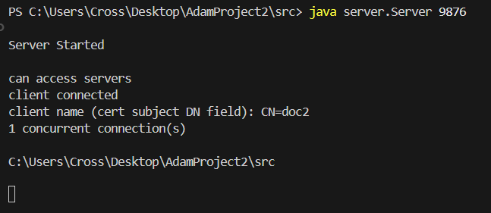
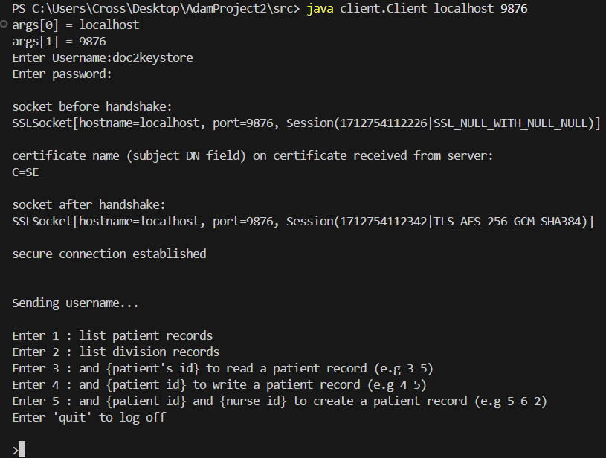
TLS connection
Notes:
TLS Handshake: When a client attempts to connect to the server, a TLS handshake is initiated. During this process, the server presents its certificate (from serverkeystore) to the client, which verifies it using its clienttruststore. If client authentication is enabled, the client also presents its certificate from its keystore, which the server verifies using its servertruststore.
Certificate Verification: All presented certificates are verified against the trust anchors in the truststores, ensuring they are signed by a trusted CA (CAHospital).

Slide 4
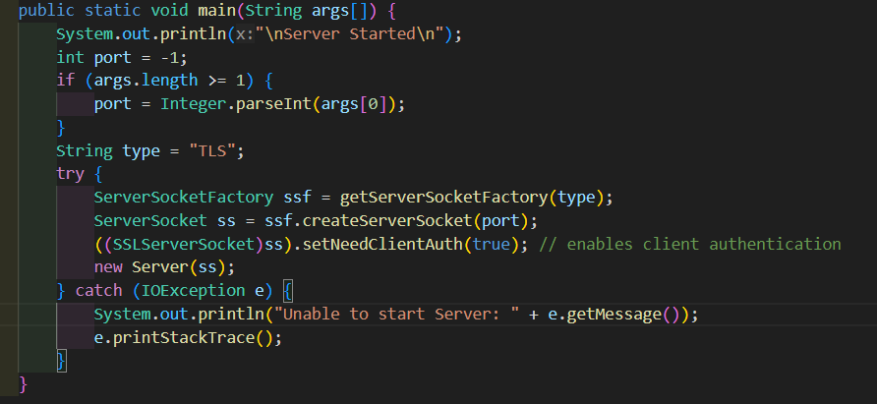
TLS connection(server side)
SSL socket creation and client authentication
SSLServerSocket is created from the factory and client authentication is enforced by calling setNeedClientAuth(true).

Slide 5
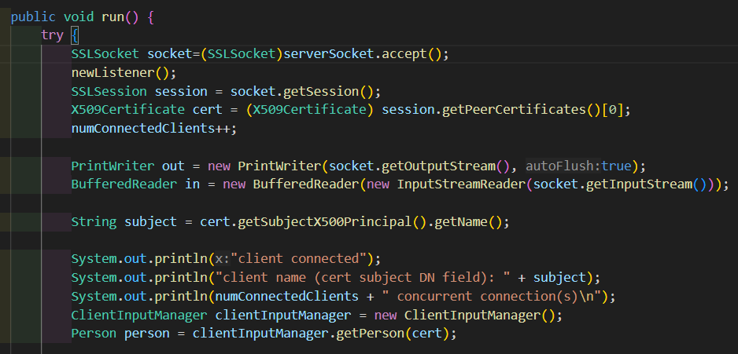
TLS connection(server side)
SSL Session and Certificate Retrieval
The server accepts the client connection (SSLSocket), starts a new session, and retrieves the client's certificate.

Slide 6
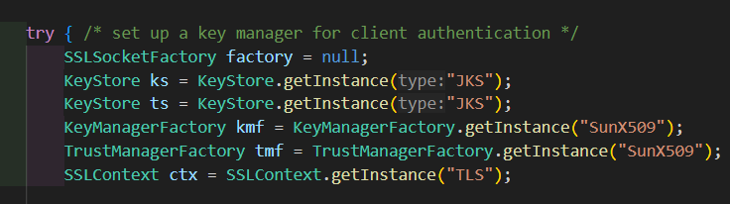
TLS connection(client side)
SSL Context and Socket Factory Configuration in main function
The setup of the SSLContext and SSLSocketFactory, including loading key and trust stores.

Slide 7
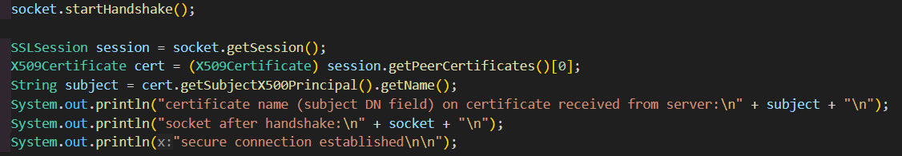
TLS connection(client side)
Server Certificate verification
Retrieving and printing the server's certificate after the handshake to verify the server's identity.

Slide 8
Functional requirements
A patient is allowed to read his/her own list of records
A nurse may read and write to all records associated with him/her, and also read all records associated with the same division.
A doctor may read and write to all records associated with him/her, and also read all records associated with the same division
Doctor can create new records for a patient provided that the doctor is treating the patient. When creating the record, the doctor also associates a nurse with the record.
A government agency is allowed to read and delete all types of records.

Slide 9
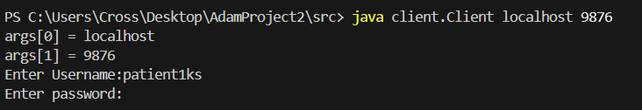
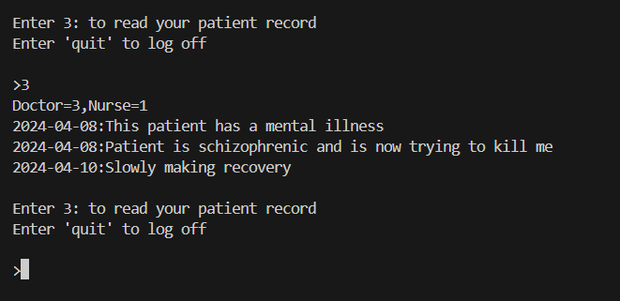
Functional requirements
A patient is allowed to read his/her own list of records
Patient 1 reading his records

Slide 10
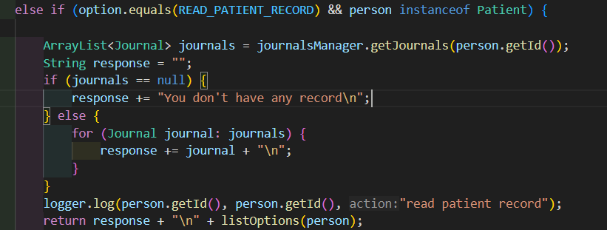
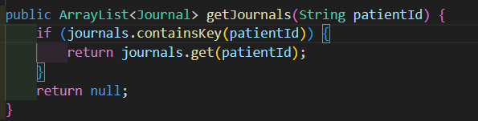
Functional requirements
A patient is allowed to read his/her own list of records
An instance of type Patient selects option to read his own record, which then calls the function to read from the journal(database)

Slide 11
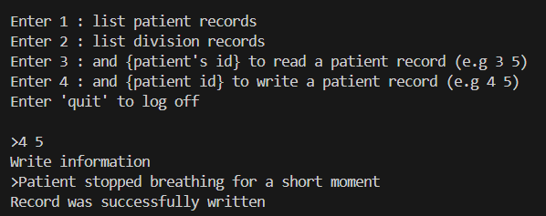
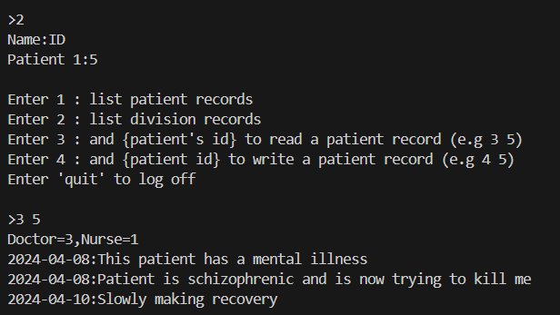
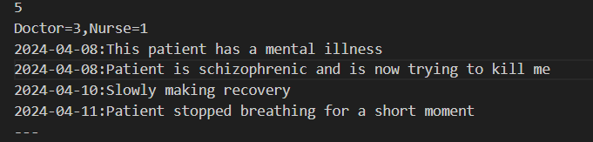
Functional requirements
A nurse may read and write to all records associated with him/her, and also read all records associated with the same division.
Nurse 1(with id 1) in listing records
in her division, and reading patient 5’s record
Nurse 1(with id 1) in writing patient 5’s
record.

Slide 12
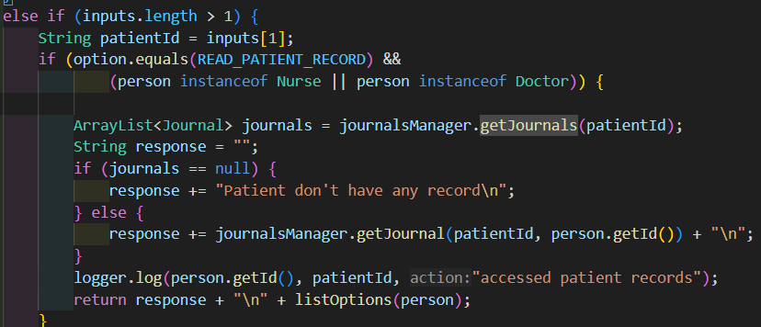
Functional requirements
A nurse may read and write to all records associated with him/her, and also read all records associated with the same division.
An instance of type Nurse selects option to read his own record, which then calls the function to read from the journal(database)

Slide 13
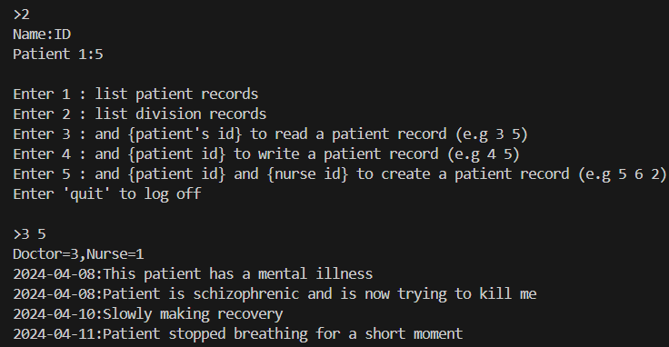
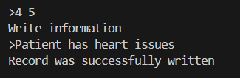
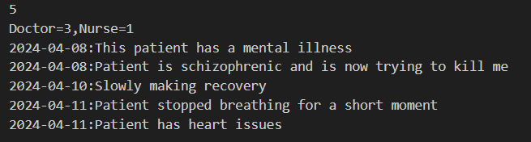
Functional requirements
A doctor may read and write to all records associated with him/her, and also read all records associated with the same division
Doctor 1(with id 3) writing to patient 5’s record
Doctor 1(with id 3) reading patient 5’s record

Slide 14
Functional requirements
A doctor may read and write to all records associated with him/her, and also read all records associated with the same division
An instance of type Doctor selects option to read patient’s record, which then calls the function to read from the journal(database)

Slide 15
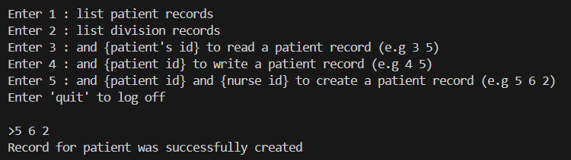
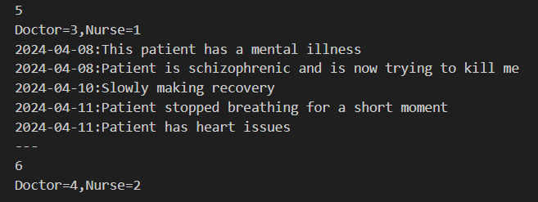
Functional requirements
Doctor can create new records for a patient provided that the doctor is treating the patient. When creating the record, the doctor also associates a nurse with the record. (only if record doesn’t exist)
Doctor 2(id 4) creates record for patient 2(id 6) and associates a nurse(id 2) with the record.
Record creation reflected in journal(database)

Slide 16
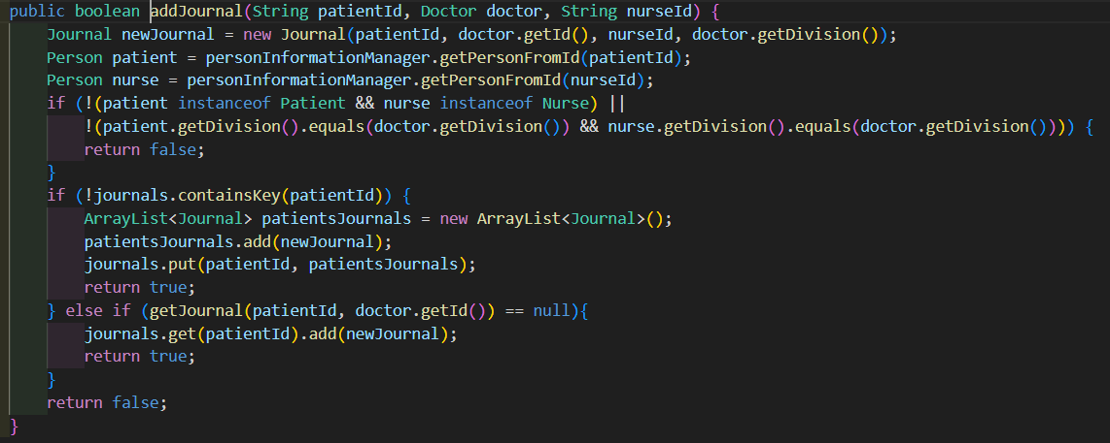
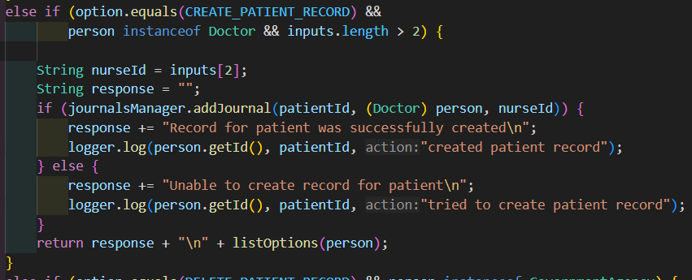
Functional requirements
Doctor can create new records for a patient provided that the doctor is treating the patient. When creating the record, the doctor also associates a nurse with the record. (only if record doesn’t exist)
Adds a new journal with patientID, doctor, and nurseID,
Validates their types, and then checks if a record already exists or not for that patient. If it does, then also check if it the same patient doctor paid.
Calling the adjournal function to create a new patient record

Slide 17
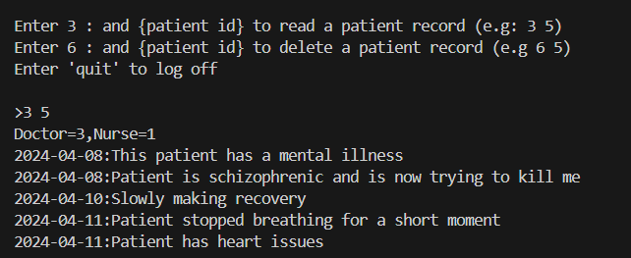
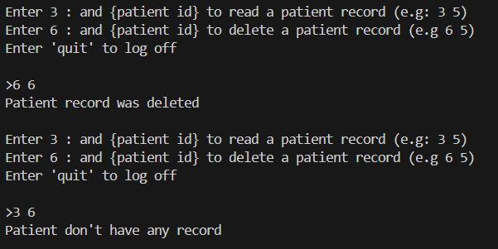
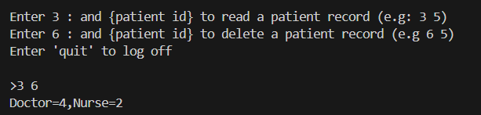
Functional requirements
A government agency is allowed to read and delete all types of records.
Government deleting patient 2’s record and then trying to read his record after deletion.
Government reading both patients’ records (patient’s 2(id 6) record is empty) .

Slide 18
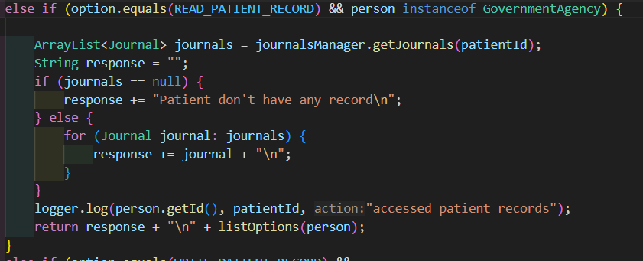
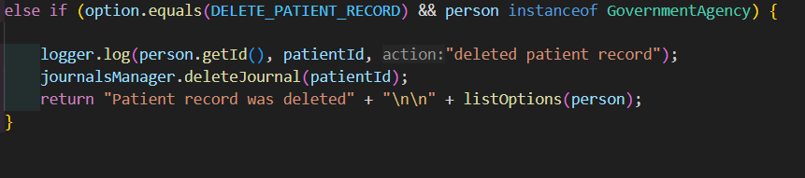
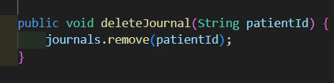
Functional requirements
A government agency is allowed to read and delete all types of records.
Lists all records in the database regardless
of division
Deletes a patient’s record by removing the
key from the hashmap

Slide 19
Thank you!

